Slide 1
Test Driven Development Microskills
with Llewellyn Falco
Week 3

Slide 2
The Testing Circle
Native language
// Create side (0,0) – (3,4)
// Verify length
Whiteboard
English
Testing Circle
Result
Code
Side (0,0) – (3,4) length = 5
Side s = new Side(0,0,3,4);
Approvals.Verify(s + “ length = “ +s.Length);

Slide 3
Benefits of Tests
Specification
Feedback
Regression
Granularity

Slide 4
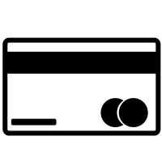

Rules for Creating Code with Consume First
Use your imagination
Write the code you want to exist, regardless of what currently does
array.isEmpty() ? null : array.get(0)
array.first()
Use it then create it
Don’t create a method/class/variable first
Use a method/class/variable, then create it
Evaluate the consequences
Ask yourself “what are the resulting classes and methods from this implementation?”
Do you like the implications?
Use Tools
Most of your code can be completed or generated by your tools. Use Autocomplete and QuickFix
Programming By Red
Read your errors, let them guide you
“Failure helps us see what success should look like”
Y.A.G.N.I
“You ain’t going to need it”
Do the simplest thing that can possibly work. You can improve it later.

Slide 5
4.
Practice – Triangles
A side has a distance
A side has endpoints
3 points
3 sides
Perimeter
Get Sides touching a point
Get sides opposite a point
The angle of 2 sides touching a point
3 angles
Right Triangle

Slide 6
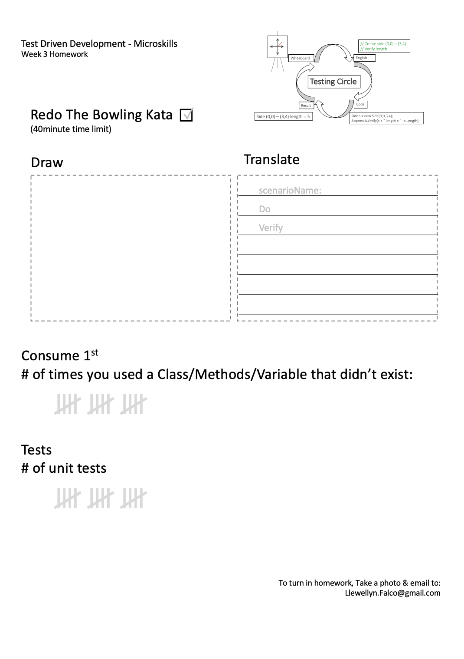
Homework
Write 4 scenarios
Count # times you used a class/method/variable that didn’t exist

Slide 7

thanks!
Any questions?
Please connect through LinkedIn & Twitter
@LlewellynFalco
Llewellyn.Falco@gmail.com
Presentation template by SlidesCarnival

